Slide 1
Osteoporosis and Diabetes
L. mahmoudieh

Slide 2
FRAX assessment in general and diabetic population
Trabecular bone score
The risk of hip and non vertebral Fx. In diabetes
Bone mineral density in general and diabetic population
TBS and diabetes-related fracture risk
Methods for improving fracture risk assessment in diabetes

Slide 3
FRAX assessment in diabetics
Trabecular bone score
The risk of hip and non vertebral Fx. In diabetes
Bone mineral density if diabetes
TBS and diabetes-related fracture risk
Methods for improving fracture risk assessment

Slide 4
A prospective, population-based, cardiovascular screening study started in the 1970s.
It consists of 33,346 probands, 22,444 men and 10,902 women.
The inclusion period for men was 1974–1984 (10 years), and for women, from 1977 to 1992 (15 years).
The primary objective of the Malmo¨Preventive Project was to describe cardiovascular risk factors and related conditions in a middle-aged population and to improve the scientific base for cardiovascular disease prevention.
The probands were followed prospectively with regard to incident fractures and mortality with a mean follow-up of 16 years (range 7–25 years) for men and 11 years (range 7–22 years) for women.

Slide 5
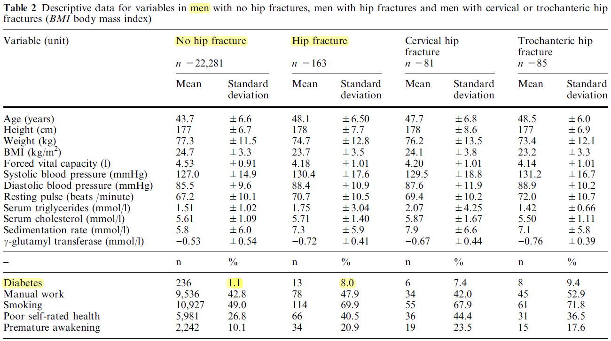
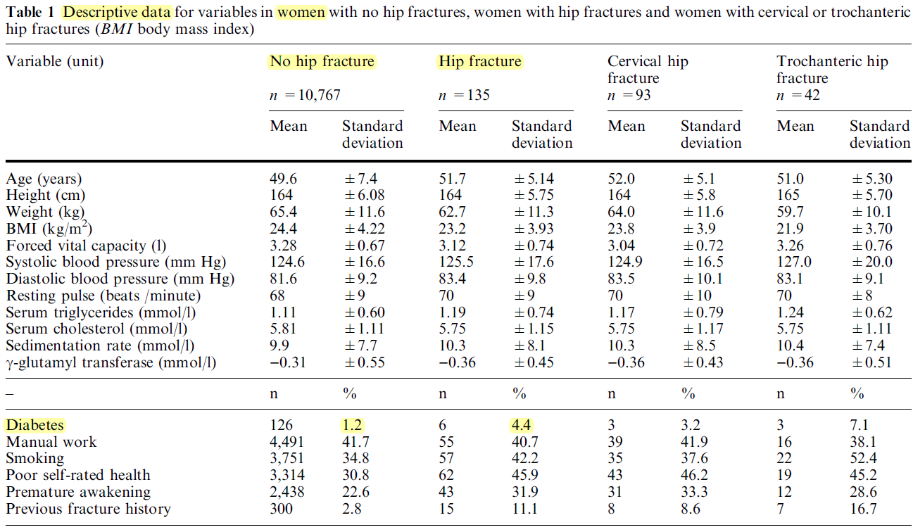

Slide 6
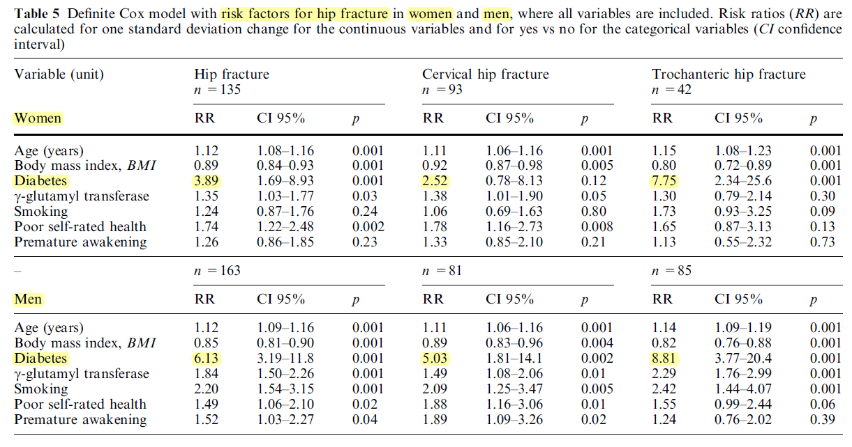

Slide 7
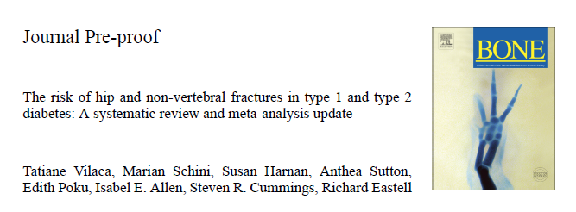
We selected a previously published review up to March 2020. We included observational studies with age and gender-adjusted risk of fractures in adults with diabetes compared to adults without diabetes
2020 Published by Elsevier S8756-3282(20)30237-4

Slide 8
Baseline characteristics:
Hip fracture:
40 studies were cohorts and 2 studies were case-control studies.
The study size varied from 238 to 3,861,874 participants. Ages varied from 20 to 100 years.
Five studies reported data just from women and five just from men. The other studies reported data from both.
nine studies reported data only from T1D participants eighteen studies reported data only from T2D participants and the others reported data from participants of both DM types or did not specify the participant’s DM type .
The majority of data reported addressed white populations.

Slide 9
Baseline characteristics(cont.):
Non-vertebral farcture:
13 studies were cohorts and 4 studies were case-control studies.
The study size varied from 216 to 1,694,051 participants. Ages varied from 20 to ≥80 years.
Six studies reported data just from women and three just from men. The other studies reported data from both.
Two studies reported data only from T1D participants ten studies reported data only from T2D participants and the others reported data from participants of both DM types or did not specify the participant’s DM type .
The majority of data reported addressed white populations.

Slide 10
The studies reported relative risk, odds ratio, hazard ratio and incidence rate ratio.
For simplicity they will be called relative risk.
19 studies were from North America; 5 from Canada and others from the USA. 16 studies were from Europe; 3 from Norway, 2 from the Netherlands, one from Austria, 3 from the United Kingdom , 2 from Denmark, 2 from Sweden two from Spain, and one from Germany. 5 studies were from Asia (Taiwan, Korea, Singapore and Israel and three from Australia .

Slide 11
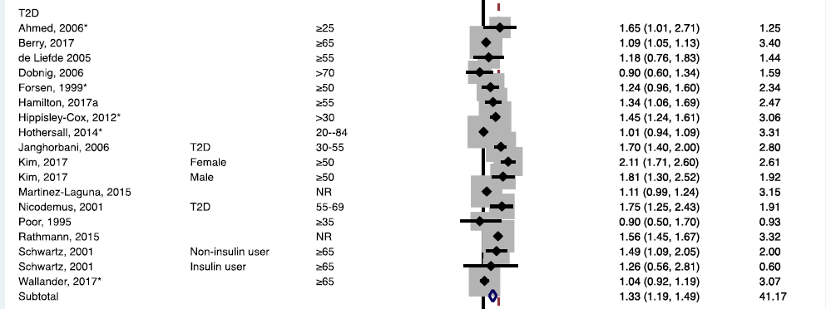
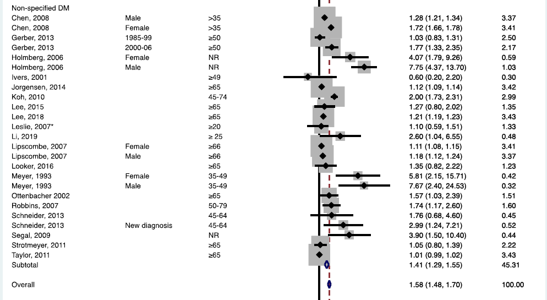

Slide 13
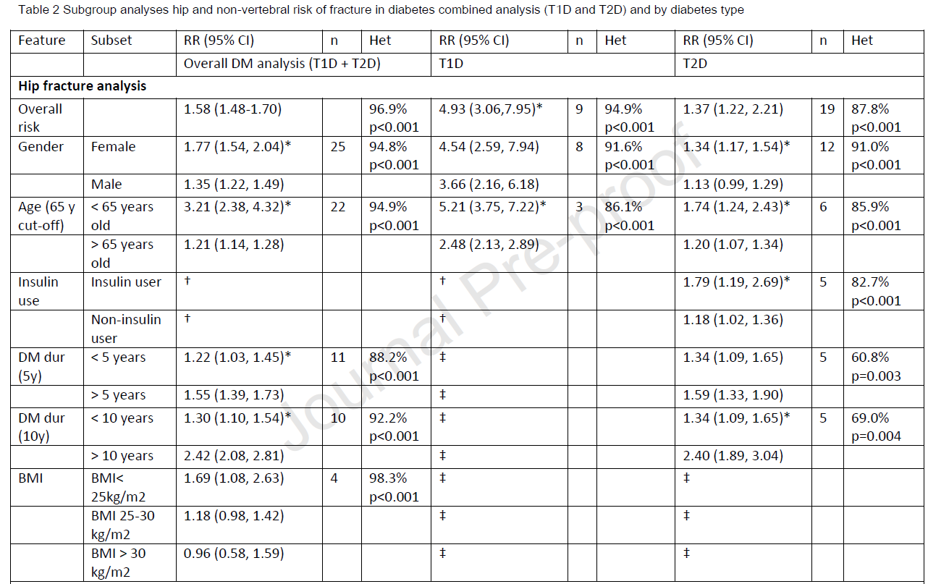

Slide 14
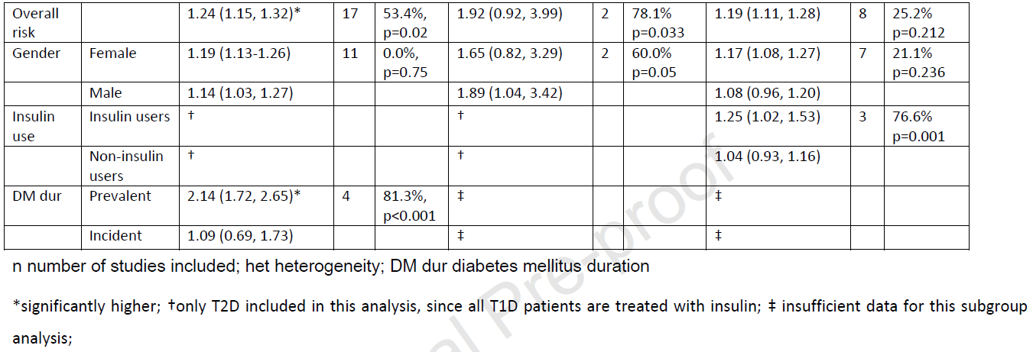

Slide 15
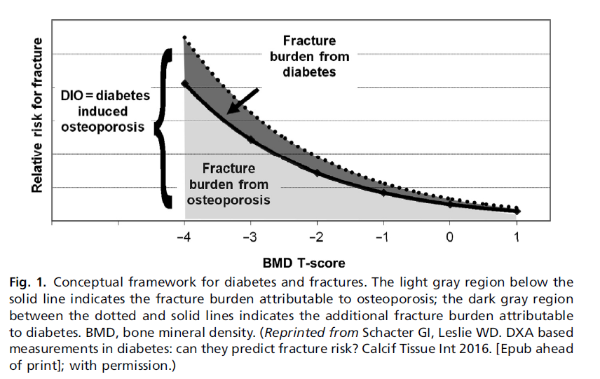

Slide 16
FRAX assessment in diabetics
Trabecular bone score
The risk of hip and non vertebral Fx. In diabetes
Bone mineral density in general and diabetic population
TBS and diabetes-related fracture risk
Methods for improving fracture risk assessment

Slide 17
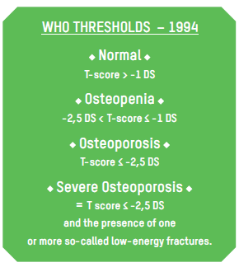
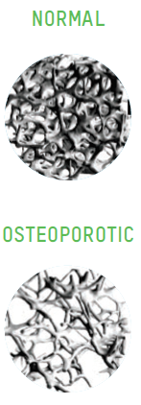
The Z-score represents the difference between the patient and the mean value for normal subjects of the same age, sex, and ethnicity, expressed in standard deviations.
It is particularly used for children, adolescents and young adults, and premenopausal women.
Finally, in the case of a Z-score < -2, screening for possible secondary osteoporosis is required.

Slide 18
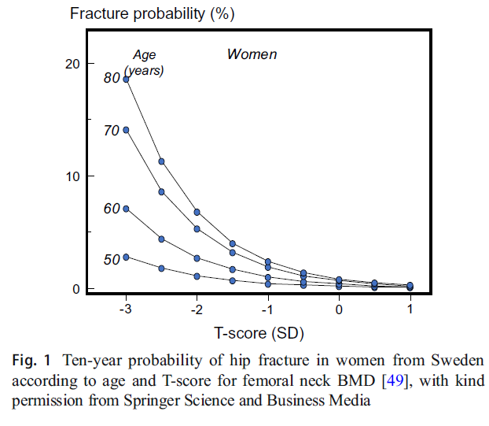
European guidance for the diagnosis and management of osteoporosis
in postmenopausal women
Osteoporosis International (2019) 30:3–44

Slide 19
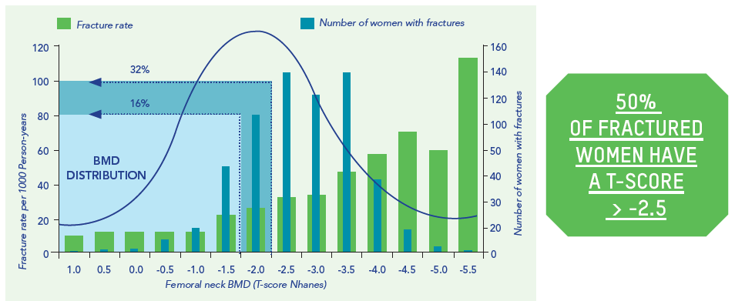
CLINICAL RISK FACTORS AND HEEL ULTRASOUND IN OSTEOPOROSIS
JOURNAL OF BONE AND MINERAL RESEARCH Volume 23, Number 7, 2008

Slide 20
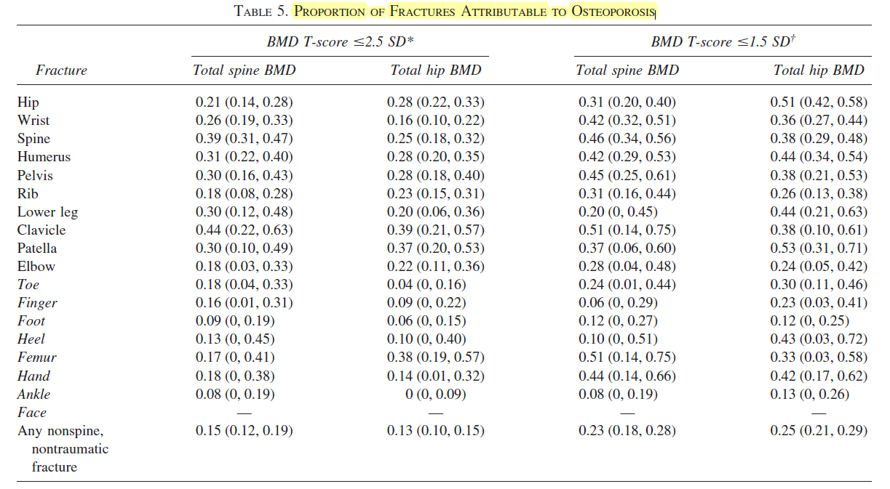
JOURNAL OF BONE AND MINERAL RESEARCH Volume 18, Number 11, 2003
Notes:
In the multicenter Study of Osteoporotic Fractures (SOF), we studied the relationship of
several different BMD measures to fracture risk of multiple types in 9704 non-black women aged 65 and older. We
previously reported on the relationship of peripheral BMD measures to risk of several types of fracture during an
average 2.2-year follow-up period. In this expanded analysis, we present results of the relationship of both peripheral
and central BMD measures and fractures of multiple types during 10.4 and 8.5 years of follow-up, respectively. We
also report population attributable risk (PAR) estimates for osteoporosis and risk of several types of fracture.

Slide 21
BMD and DM I
Bone mineral density Reduced bone density in patients with T1D as compared with normal controls has been demonstrated in a metaanalysis.
However, the decrease in BMD reported in subjects with T1D only partially explains the observed 6.4- to 6.9-fold higher hip fracture risk (expected approximately 1.42) compared with individuals without diabetes.
Endocrinol Metab Clin N Am 46 (2017) 63–85
Diabetes and Bone Disease

Slide 22
BMD and DM II
Metaanalyses provide robust evidence for normal or even high BMD at both the hip and the spine in T2D, although there is paradoxically increased fracture risk.
Endocrinol Metab Clin N Am 46 (2017) 63–85
Diabetes and Bone Disease

Slide 23
FRAX assessment in general and diabetic population
Trabecular bone score
The risk of hip and non vertebral Fx. In diabetes
Bone mineral density if diabtics
TBS and diabetes-related fracture risk
Methods for improving fracture risk assessment

Slide 24
Fracture risk assessment tool(FRAX)
Fracture Risk Assessment Tool (FRAX) was launched by the University of Sheffeld in 2008 with 8 country-specific models.
The number of FRAX models had increased from 8 to 30 and currently provide coverage for over 80% of the global population
It estimates the 10-year probability of hip fracture and major osteoporotic fracture (hip, clinical spine, proximal humerus, or forearm) using easily obtainable clinical risk factors for fracture.

Slide 25
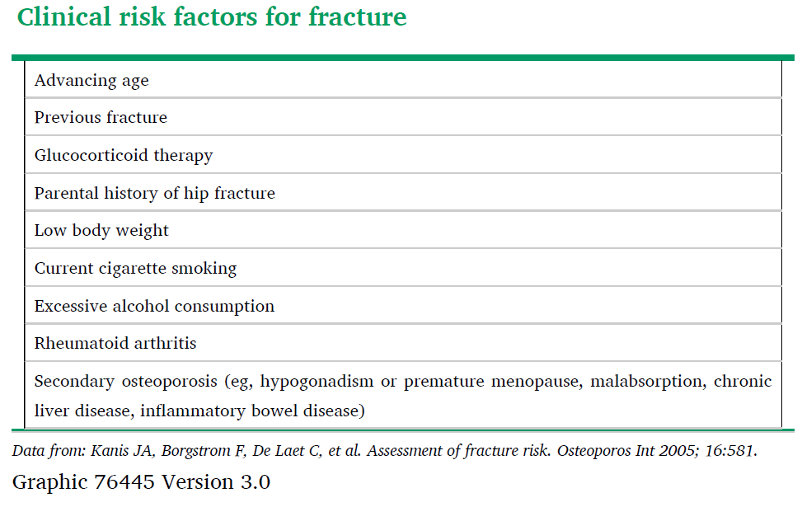
femoral neck BMD (g/cm2, using dual-energy x-ray absorptiometry [DXA]), when available
Notes:
DXA-equivalent femoral neck BMD derived from quantitative computed tomography (QCT) measurements may also be used with FRAX [29]; however, this is not recommended for use in clinical practice unless DXA is not available, due to greater radiation exposure and higher cost.

Slide 26
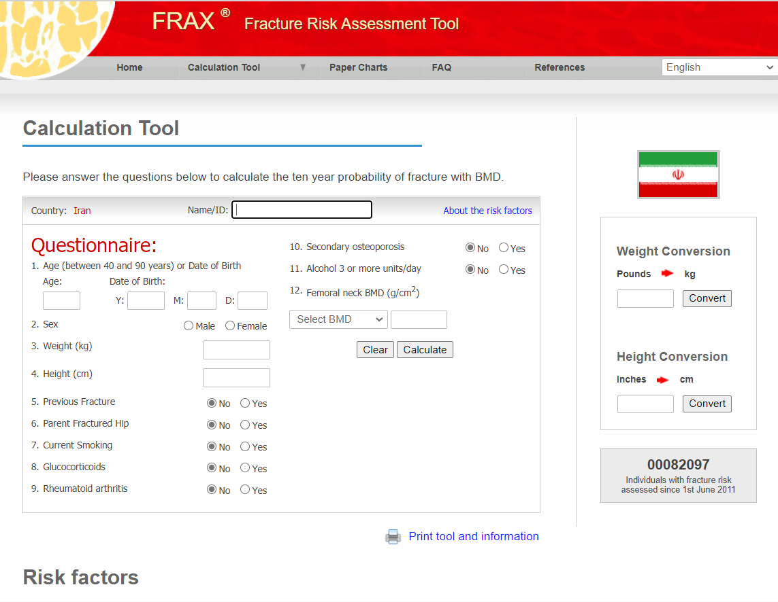
https://www.sheffield.ac.uk/FRAX/tool.aspx?country=68

Slide 27
The FRAX-predicted risk and observed incidence of major osteoporotic fracture in both untreated and treated women were concordant.
Thus, osteoporosis therapy may not preclude the use of FRAX for fracture prediction.
However, FRAX does not appear to capture the change in fracture risk associated with therapy and should not be used to monitor individuals on therapy
UpToDate

Slide 28
FRAX may underestimate fracture probability in individuals with
● Lumbar spine BMD much lower than femoral neck BMD
●Multiple or recent fractures
●High-dose glucocorticoid exposure (prednisolone >7.5 mg/day or equivalent)
●Prevalent, severe vertebral fractures
●A parental history of non-hip fragility fracture
●Diabetes mellitus (has not a direct input variable )
UpToDate
Notes:
The FRAX algorithm uses femoral neck BMD (g/cm2) for calculation of fracture probability in untreated
patients. BMD input from non-hip sites and other hip regions of interest has not been validated with FRAX
and is therefore not recommended [24]. For patients who have lumbar spine BMD that is much lower than
femoral neck BMD, FRAX is likely to underestimate fracture risk. It is noteworthy that the FRAX estimation
of major osteoporotic fracture does not include all osteoporotic fractures, since a substantial portion of
fragility fractures are not at the four "major" skeletal sites used in the FRAX algorithm [46]. Additional
limitations, which may result in over- or underestimation of fracture risk in an individual patient, include
dichotomous (yes or no) input for clinical risk factors that are associated with variable risk depending on
dose and duration of exposure (eg, glucocorticoids) and lack of consideration of all risk factors (eg,
multiple fractures, recent fractures, severity of fractures, falls, bone turnover). While there is evidence that
hip, vertebral, and humeral fractures appear to confer greater risk of subsequent fracture than fractures at
other sites, quanti􀉹cation of this incremental risk in FRAX is not possible.

Slide 29
Fracture prediction tools (FRAX) and DM
DM is not presented as a primary entry variable in the FRAX algorithm, but is considered one of the potential causes of secondary osteoporosis, and as such is given the same weight as rheumatoid arthritis (the prototype for all causes of secondary osteoporosis).
Importantly, coding secondary osteoporosis only increases fracture probability when BMD is not included in the FRAX calculation.
Endocrinol Metab Clin N Am 46 (2017) 63–85
Diabetes and Bone Disease

Slide 30
FRAX assessment in diabetics
Trabecular bone score
The risk of hip and non vertebral Fx. In diabetes
Bone mineral density if diabtics
TBS and diabetes-related fracture risk
Methods for improving fracture risk assessment

Slide 31
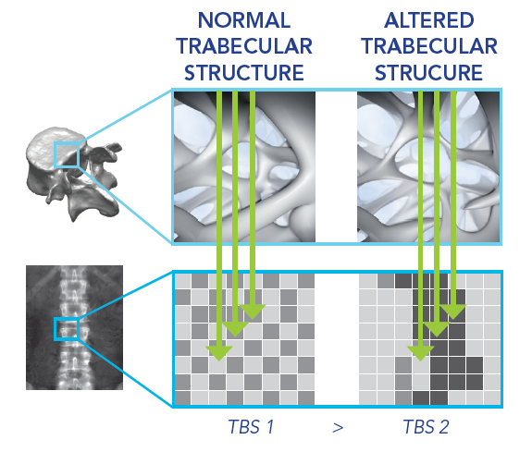
TBS is strongly, positively correlated with the number of spans and with their connectivity, and negatively with the average size of the spaces between spans .
That is to say that a high TBS value means that the bone microarchitecture is dense and well-connected, with little space between spans

Slide 32
a dual-energy X-ray absorptiometry (DXA)-derived image texture measurement, is a risk factor for major osteoporotic fracture (MOF) and hip fracture (HF) independent of 10-year fracture probability estimated using FRAX.
Journal of Bone and Mineral Research, Vol. 32, No. 7, July 2017, pp 1568–1574

Slide 33
TBS is typically measured at the LS (from L1 to L4) using the same regions of interest as for conventional BMD measurement, and the result is given for each vertebra and for the overall region of interest.
TBS can be applied to DXA images obtained from current generation fan-beam densitometers, either at the time of the image acquisition or retrospectively.
Journal of Bone and Mineral Research, Vol. 32, No. 7, July 2017, pp 1568–1574

Slide 34
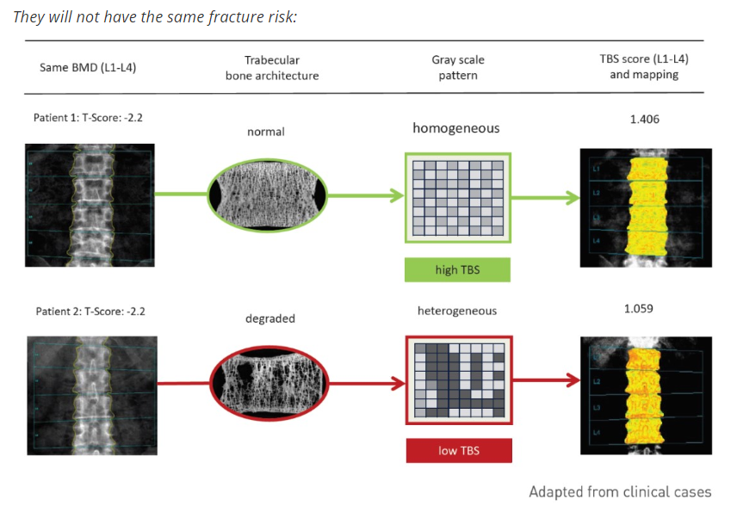

Slide 35
BMD is only an assessment of bone mass. It does not provide information on bone quality, another key parameter describing bone.
In addition, fracture clinical risk factors are, at best, an indirect assessment of bone quality.
One important way to describe bone quality is to assess its microarchitecture.
Seeman E, Delmas PD N Engl J Med 2006

Slide 36
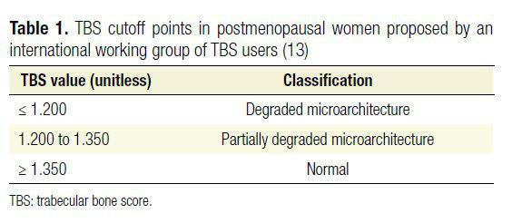
There is no consensus regarding what constitutes‘‘normal’’ or ‘‘abnormal” TBS, but the manufacturer has proposed the following TBS cutoff points:
The differences in TBS by gender and ethnicity were small and much lower than BMD differences.
Journal of Bone and Mineral Research, Vol. 32, No. 7, July 2017, pp 1568–1574

Slide 37
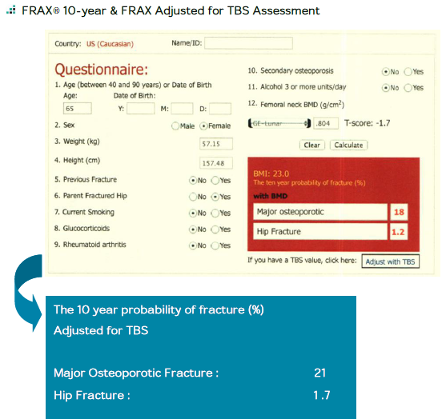
18%
1.2
Adjust for TBS
Treatment:
MOF≥20%
Or
HF≥3%

Slide 38
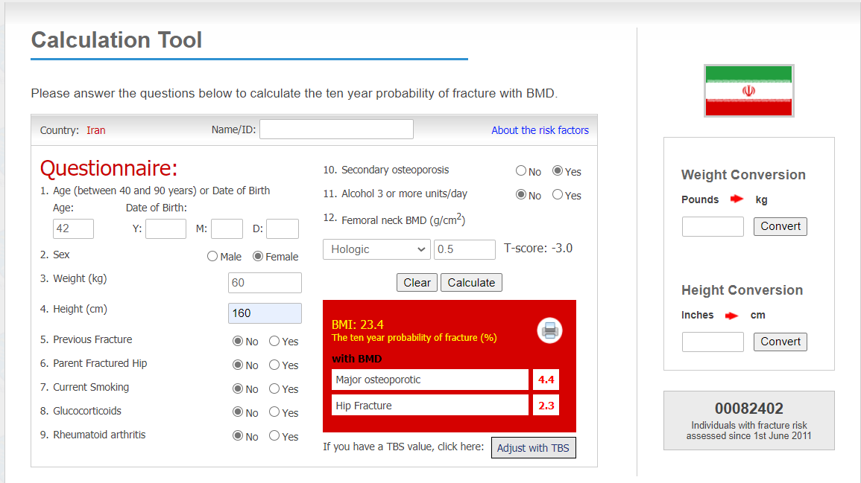

Slide 39
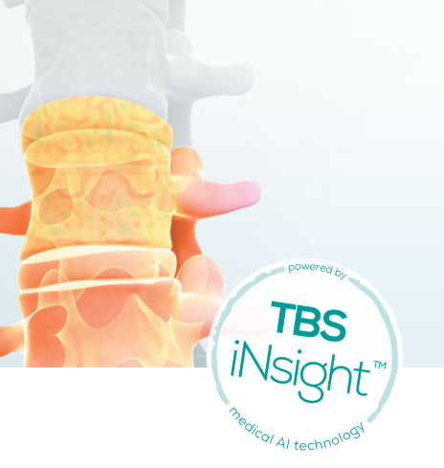
https://www.medimapsgroup.com/tbs-osteo
TBS iNsight is a software program to evaluate bone microarchitecture in clinical practice and enhance fracture risk prediction.

Slide 40
TBS is associated with:
vertebral, hip, and MOF risk in postmenopausal women
hip fracture risk and MOF risk in men over age 50 years
It is potentially useful as a component of monitoring the skeletal effects of anabolic agents, provided precision assessment has been done and the least signifficant change (LSC) has been calculated.
UpToDate

Slide 41
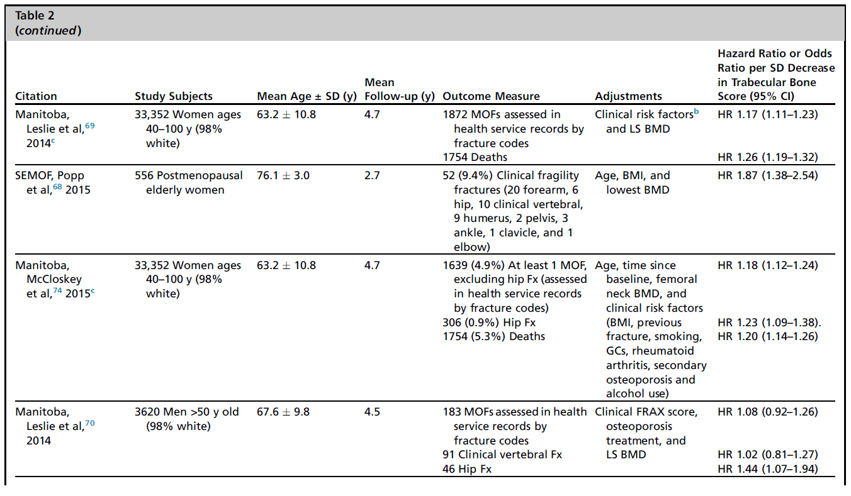
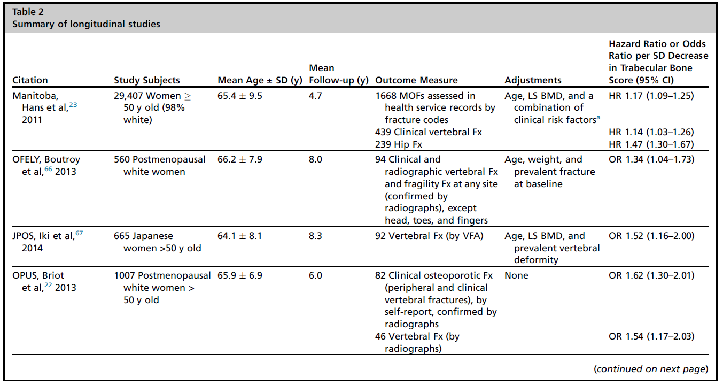
Several longitudinal studies have shown that TBS predicts fracture risk in women and men greater than 40 years old

Slide 42
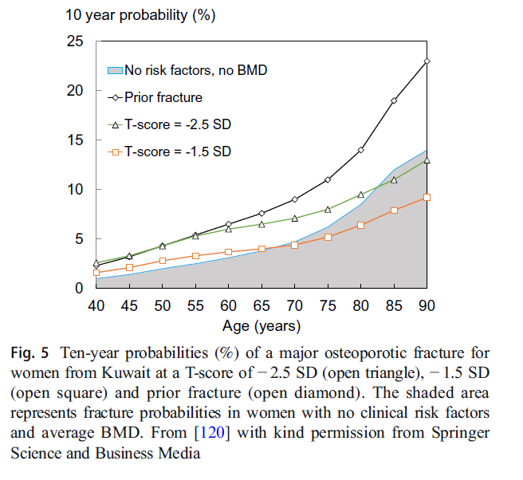
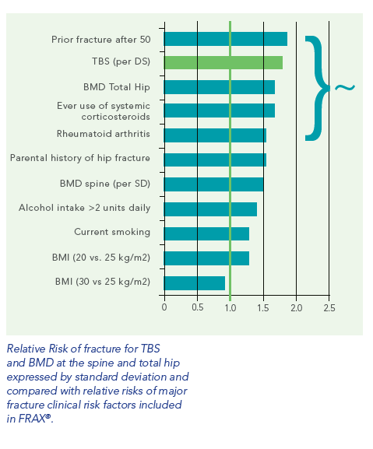
European guidance for the diagnosis and management of osteoporosis
in postmenopausal women
Osteoporosis International (2019) 30:3–44

Slide 43
In contrast to DXA-derived BMD, osteoarthritic changes of the LS seem to have little effect on TBS.
Similarly, TBS may not be affected by the presence of other heterotopic ossifications that typically overestimate LS DXA BMD.
Journal of Bone and Mineral Research, Vol. 32, No. 7, July 2017, pp 1568–1574

Slide 44
Similar to BMD derived from DXA, TBS results may not be comparable across different DXA machines or scan modes.
Greater TBS values derived from higher-resolution DXA images, as acquired using a Lunar iDXA scan, than those derived from lower-resolution images obtained on a Prodigy
Journal of Bone and Mineral Research, Vol. 32, No. 7, July 2017, pp 1568–1574

Slide 45
The excessive amount of abdominal soft tissue can also influence the TBS analysis, degrading the image texture and thus reducing the TBS values.
As a result of the BMI/abdominal adiposity dependence, the manufacturers of the TBS software have not recommended the use of TBS in individuals with BMI lower than 15 kg/m2 or greater than 37 kg/m2
Journal of Bone and Mineral Research, Vol. 32, No. 7, July 2017, pp 1568–1574

Slide 46
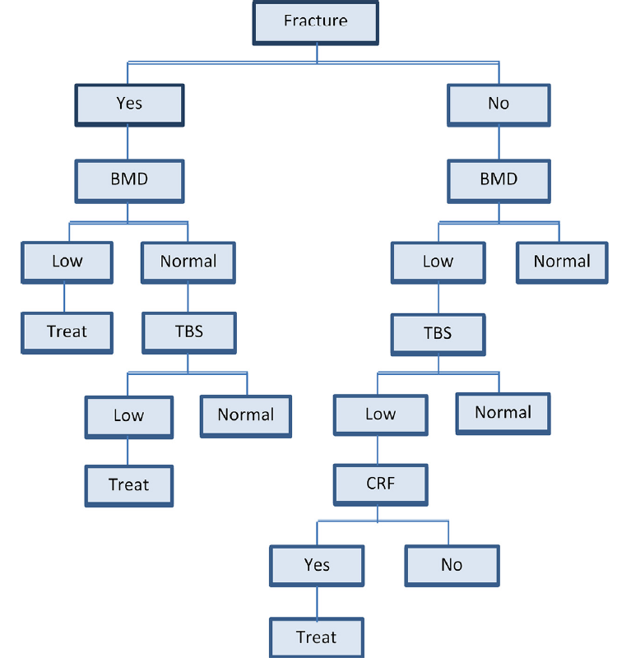
The management algorithm for patients with or without fractures, considering their trabecular bone score (TBS) values.
Journal of Clinical Densitometry: Assessment & Management of Musculoskeletal Health, vol. ■, no. ■, 1–12, 2017

Slide 47
FRAX assessment in diabetics
Trabecular bone score
The risk of hip and non vertebral Fx. In diabetes
Bone mineral density if diabtics
TBS and diabetes-related fracture risk
Methods for improving fracture risk assessment

Slide 48
Objective: This study evaluated the ability of lumbar spine TBS to account for increased fracture risk in diabetes.
Design and Setting: We performed a retrospective cohort study using BMD results from a large clinical registry for the province of Manitoba, Canada.
Patients: We included 29,407 women 50 years old and older with baseline DXA examinations,among whom 2356 had diagnosed diabetes.
J Clin Endocrinol Metab 98: 602–609, 2013

Slide 49
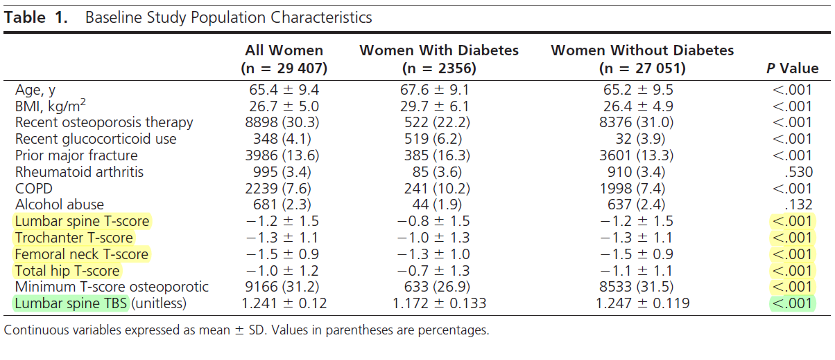

Slide 52
TBS may also have a role in the assessment of fracture risk in some causes of secondary osteoporosis (e.g. diabetes, hyperparathyroidism and glucocorticoid-induced osteoporosis).
European guidance for the diagnosis and management of osteoporosis
in postmenopausal women
Osteoporosis International (2019) 30:3–44

Slide 53
FRAX assessment in diabetics
Trabecular bone score
The risk of hip and non vertebral Fx. In diabetes
Bone mineral density if diabtics
TBS and diabetes-related fracture risk
Methods for improving fracture risk assessment in diabetes

Slide 54
four proposed methods to improve the performance of FRAX for type 2 diabetes:
(1) the rheumatoid arthritis (RA) input to FRAX
(2) the trabecular bone score (TBS)-adjustment to FRAX
(3) reducing the femoral neck T-score input to FRAX by 0.5 SD
(4) increasing the age input to FRAX by 10 years.
Notes:
this is justified by the similar weights accorded RA and type 2 diabetes in the QFracture algorithm (31, 32).
justified by the observation in several studies that TBS is lower in those with type 2 diabetes than in the general population
this follows from the observation that a T-score in a woman with DM is associated with hip fracture risk equivalent to a woman without DM with a T-score of approximately 0.5 units lower
this is comparable to the femoral neck BMD loss of 0.5 SD expected over 10 years.

Slide 55
a registry-based cohort study to examine major osteoporotic fractures (MOF) and hip fractures (HF) over mean 8.3 years observation among 44,543 women and men 40 years of age or older (4136 with diabetes) with baseline lumbar spine and hip DXA during 1999-2016.
Journal of Bone and Mineral Research, 2018

Slide 56
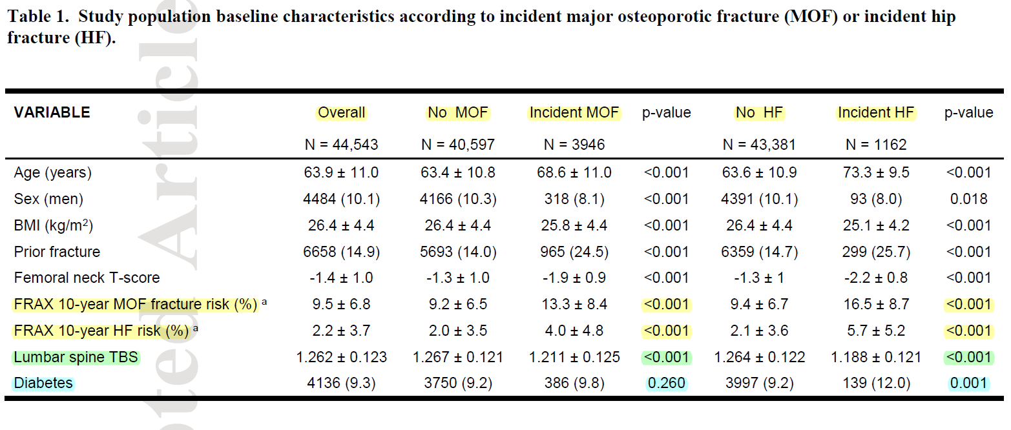

Slide 57
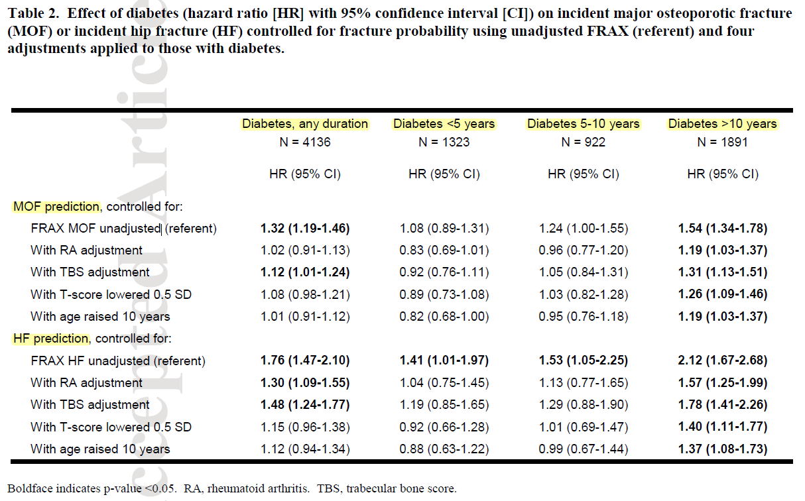
Notes:
After controlling for the standard unadjusted FRAX probability, diabetes (all durations combined) was associated with significantly increased risk for incident MOF (HR 1.32, 95% CI 1.19 – 1.46) and incident HF

Slide 58
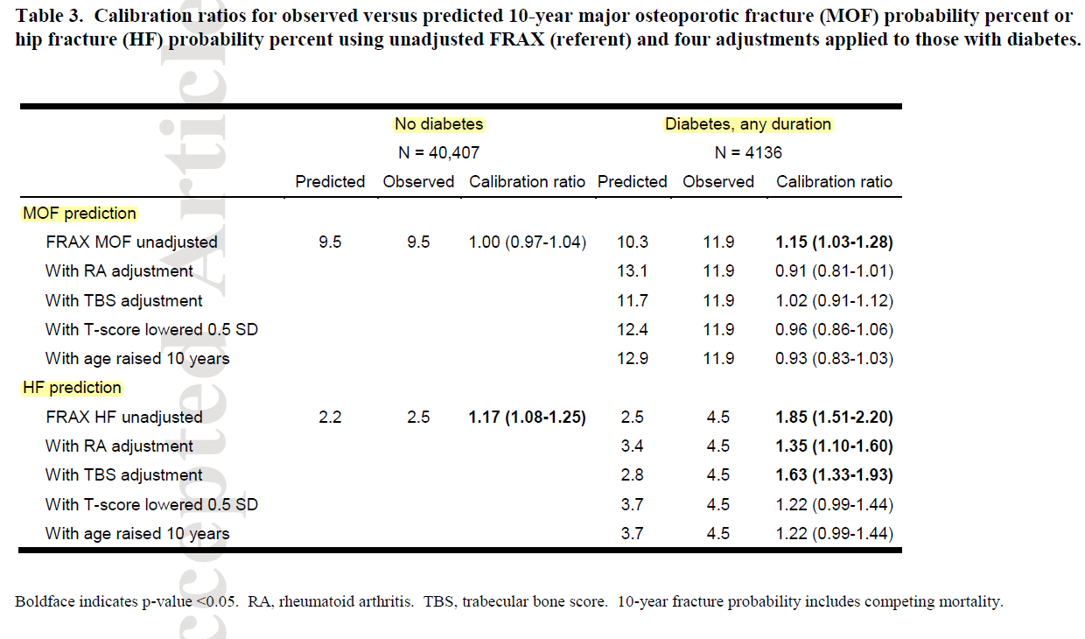

Slide 59
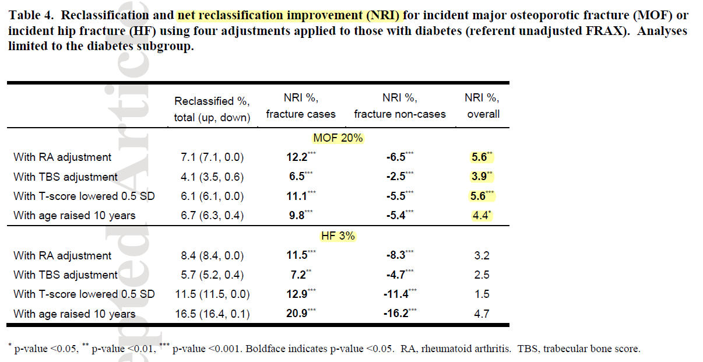

Slide 60
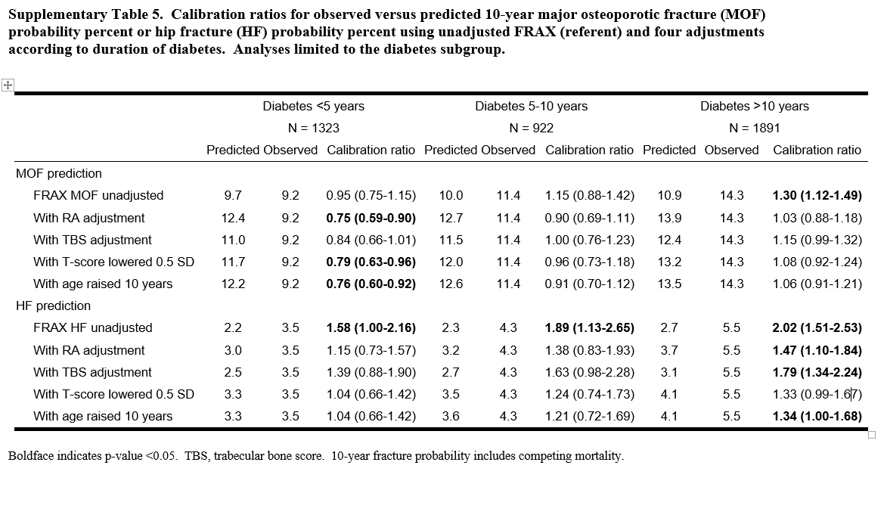

Slide 61
In conclusion, each of the proposed methods for addressing limitations in the ability of FRAX to assess fracture risk in individuals with diabetes was found to improve performance, though no single method was optimal in all settings.

Slide 62
BMD, itself cannot be assumed to have a good predictable effect on fracture risk in diabetes.
FRAX has strong limitation in fracture assessment in diabetes.
TBS is a promising method to improve FRAX tool in diabetes although further studies is recommended.
Other studies for TBS with longer duration of follow up and assessment of treatment is recommended.
Take Home Message

Slide 63
Thank you for your attention

